Slide 1
Neem-Seed Processing Equipment for Nepalese Farmers and Rural Entrepreneurs
Brendan Metzger University of Guelph

Slide 2
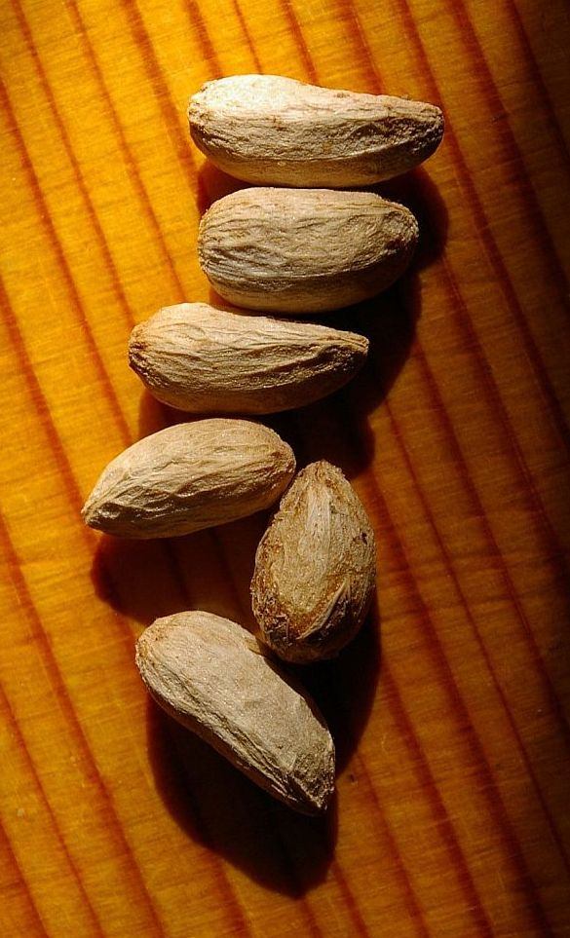
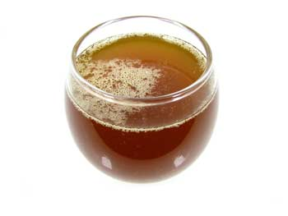
Neem Processing Tools
To this valuable oil!
To convert these seeds…

Slide 3
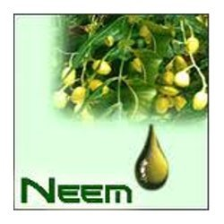
Mission:
-To facilitate the growth and development of Nepalese entrepreneurs and small businesses by introducing tools and equipment for the purpose of extracting value from a commonly found and easily accessible natural resource (neem).

Slide 4
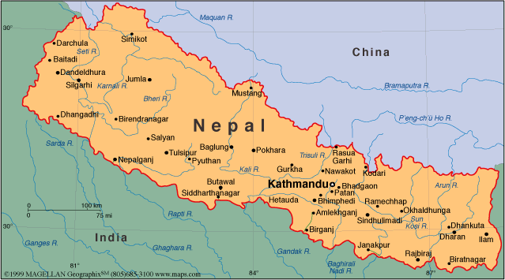
Target Nation:
Nepal
Between India and China
Varied topography
GDP ~$19.3 Billion
25.2% below poverty line
Source: UN 2010

Slide 5
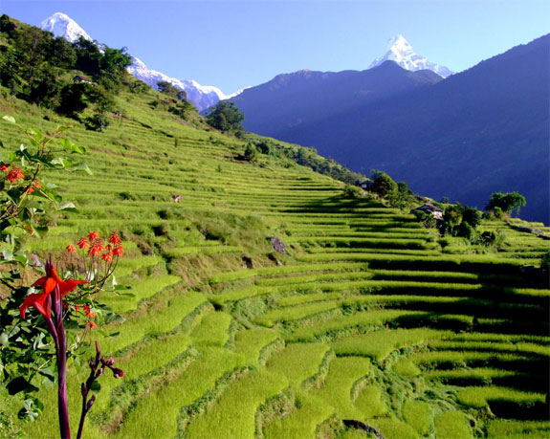
Nepal
-Population of ~29.9 million people
-Over 80% of the population lives in a rural area
-25.4% of total land base is forested
Source: UN 2010

Slide 6
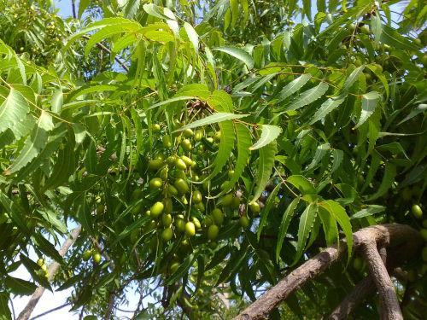
Neem
Widespread across much of Asia and Africa (both farmed and wild)
Valuable as a bio-pesticide, alternative to commercial insecticides
Various other uses, potential as a cash crop

Slide 7
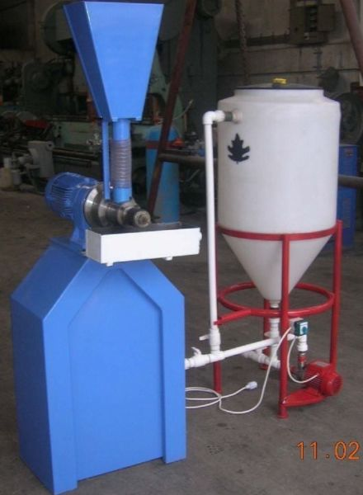
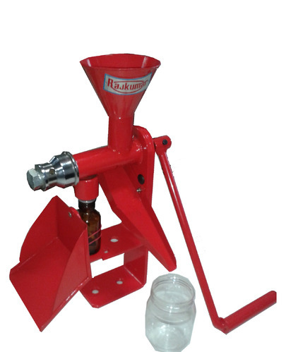
Oilseed Presses
<- Large -scale
Entry Level Size ->

Slide 8
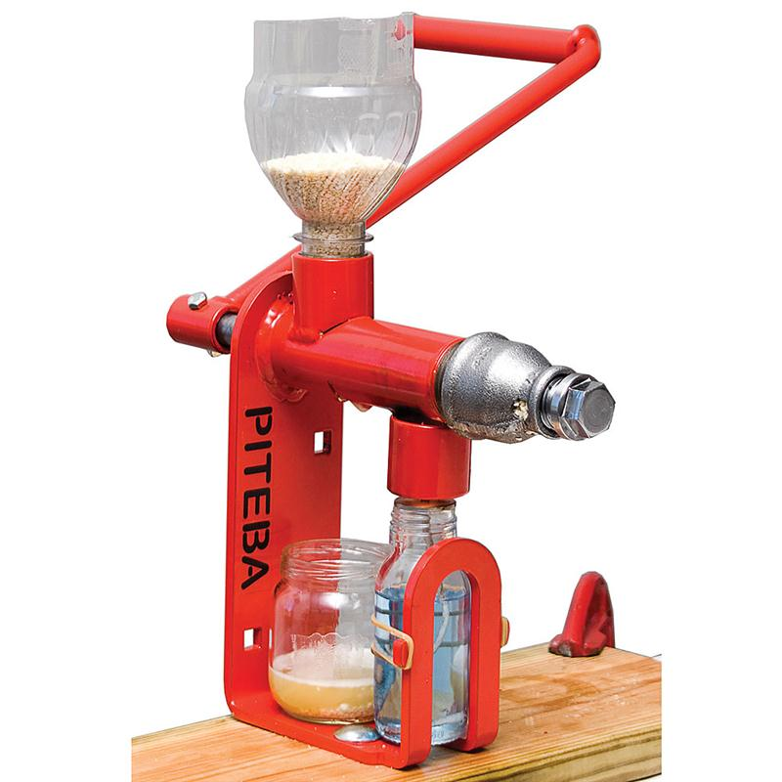
Small Scale Presses
Inexpensive
Easy to use
Minimal shipping costs
Not currently available through Canadian retailers

Slide 9
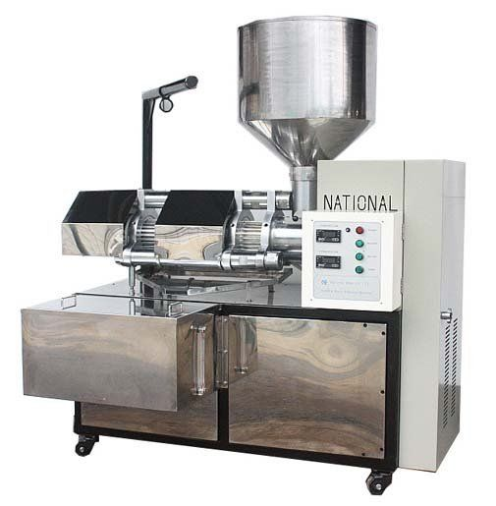
Larger Scale Equipment
Available through Canadian distributors
Capacity means there is potential for oil extraction to be sole income source (entrepreneurs)

Slide 10
Manufacturers and Retailers
1.
-Rajkumar Agro Engineers Pvt. Ltd.
-Based in India
-Both manufacture and sell small scale and medium scale oilseed processing equipment
2.
-TradeFlex
-Based in Ontario
-Manufacture, sell and service a wide range of large scale oilseed pressing equipment

Slide 11
Brendan Metzger
University of Guelph in partnership with IDRC, CIFSRF and DFAIT
Faculty Sponsor: Prof. Manish Raizada (raizada@uoguelph.ca)
Total presentation time: 4:26 mins
-For additional information a detailed written report is also available on this website http://agtradenepalcan.weebly.com/

Slide 12
References
World Statistics Pocket Book. (2011). Retrieved October 30, 2014, from http://www.un.org/ru/publications/pdfs/world statistics pocketbook 2011_en.pdf
Nepal, (n.d.) Retreived October 27 2014 from http://www.worldbank.org/en/country/nepal
Stone, R. (1992). A biopesticidal tree begins to blossom: Neem seed oil has insect toxicologists buzzing about its potential as a source of natural insecticides. Science, 255, 1070+.
Rajkumar Agro Engineers Pvt. Limited http://www.rajkumaragromachines.com/oil-mill-plants.html
TradeFlex- Personal conversation via phone and email
http://agtradenepalcan.weebly.com/

