Slide 1
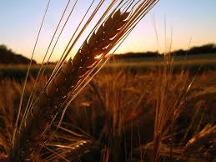
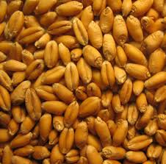
Winter Wheat
By: Karyn Marshall, University of Guelph
Notes:
Winter Wheat, name and school

Slide 2
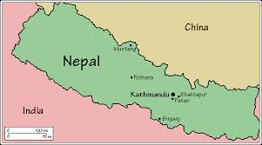
N
E P A L
Capital city: “Kathmandu” and it is the largest city.
Population 27 million
5 general climate zones
3 main geographical regions
Notes:
The country of Nepal is located between India and China. Within the country there are a 5 climate zones; tropical/subtropical zone, temperate zone, cold zone, subarctic zone and lastly the arctic zone. Nepal also has 3 main geographical regions; lowlands plains, hill region and the mountain region. In the north end of the country their typical weather is; cool summers and severe winter where as the south end experiences warm tropical summers and mild winters.

Slide 3
Export Idea: Winter Wheat
Wheat
Company
Varieties
Products
Advantages
Notes:
Export idea to Nepal: Winter wheat
Company, Varieties of Wheat, Products and Advantages

Slide 4
COMPANY
C&M SEEDS
History
Location
Mission
Notes:
Company: C&M Seeds
History: Began operations in 1978 when the Cameron and McLaughlin families (hence C & M) decided to open a seed company. Both families had been producing pedigreed seed, so choosing this industry was only natural. The company started locally, but today they have approximately 250 respected dealers all across Canada and they are still growing.
Location: C&M Seeds company is located in Palmerston , Ontario.
Mission: The company mission is to advance the future of agriculture and the rural economy in Ontario. With the advancements in their genetics and a strong push on the marketing varieties we develop, and they will do everything they can to make agriculture and crop production a prosperous venture.

Slide 5
Varieties Of Winter Wheat
Hard Red Winter
1) Gallus
2) Priesley
3)Keldin
4)Prinction
Hard White Winter
1) Whitebear
Soft Red Winter
1) CM 249
2) CM 614
3) Brooklyn
Notes:
Three types of Winter wheat:
Hard Red Winter, Hard White Winter, Soft Red Winter.
Listed are the different types, of variety.

Slide 6
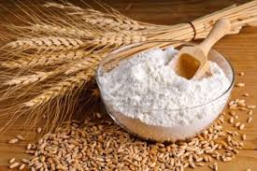
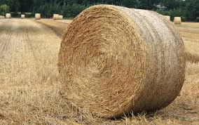
P
R O D U C T S
Notes:
Depending on the type of winter wheat depends on the products you can for the most part its food.
Hard Red; has a low count in saturated fat, cholesterol, sodium and has a high amount of dietary fiber, it provides flour for different breads.
Hard White; provides a sweeter taste in whole wheat products, can be used for bread or brewing.
Soft Red; Low-protein wheat, used for cakes, pie crusts, biscuits, and muffins.

Slide 7
ADVANTAGES
Weather Resistant
Competitive Advantage
Higher Yields
Saves Money
Notes:
Some of the Advantages of winter wheat include:
Weather resistant: winter wheat is able to survive any winter. The wheat is planted in the september- november months, goes into a vegetative state during the winter months and continues grow in the spring.
Competitive Advantage: winter wheat has the advantage over other weeds and pests. The crop efficiently uses spring moisture, and increases economics. By starting growth in the early spring it gives itself a head start in beating the spring weeds.
Higher Yields: Trends have shown that winter wheat provide higher yields.
Saves Money: Since the wheat has the ability to beat the spring weeds, this saves farmers the cost of a spring herbicide application.

Slide 8
Thanks For Watching!
Name: Karyn Marshall
University of Guelph in partnership with IDRC, CIFSRF and DFAIT
Faculty Sponsor: Prof. Manish Raizada (raizada@uoguelph.ca)
Presentation Time: 4 minutes, 47 seconds.
For Further Information Visit:
C&M Seeds Webpage, contact information is listed: http://www.redwheat.com/index.html

