Slide 1
Milk Pasteurization Equipment
Shannon Crocker
University of Guelph

Slide 2
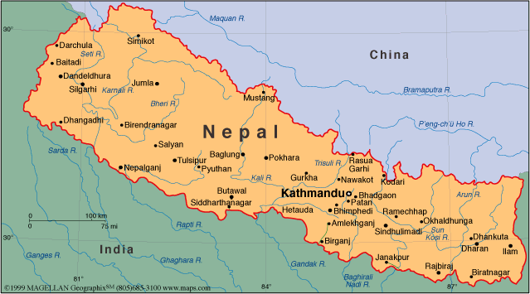
About Nepal
Landlocked by India and China
Capital Katmanduo
http://commons.wikimedia.org/wiki/File:Flag_of_Nepal.svg
http://www.nepembassy.org.uk/fact_file.php
Notes:
Nepal is a very small country that is landlocked by India and China. The capital of Nepal is a historical city called Kathmanduo which is home to about one and a half million. poeple.

Slide 3
Topographical Features
http://www.nepembassy.org.uk/fact_file.php
Notes:
Nepal is made up of three different topographical features. The three topographical features are the hilly region, the fertile valleys and the plains terri. Nepal Climate is also very diverse because of these topographical feature. In the hilly region the climate is much colder, the fertile valleys tend to have more milder weather and in the plains it tends to be on the warmer side.

Slide 4
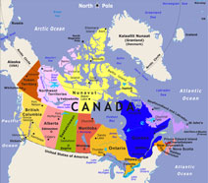
About Canada
Nothern Hemisphere
10 provinces
3 territories
9,976,185 square kilometers
http://www.map-of-canada.org/
Notes:
Canada is a country that is located in the Northern Hemisphere. It has 10 provinces and 3 territories. The total area of Canada is 9 million, 976 thousand, and 185 square Kilometers.

Slide 5
Product: Milk pasteurization equipment
Company Tetra Pak
Tetra Plex M Plate Heat Exchanger
Help Canada’s economy
Provide jobs for Canadians
http://www.canadianpackaging.com/events/tetra-pak-idea-execution-137616/
http://www.tetrapak.com/usprocessing/heat-exchangers/plate-heat-exchangers
Notes:
The product I chose to export to Nepal was milk pasteurization equipment. The company Tetra Pak produce a milk pasteurizer called Tetra Plex M Plate Heat Exchanger. Tetra Pak is the world’s leading food processing and packaging solution company. The Tetra Plex M Plate Heat Exchanger has a very reliable design so the product will not break easily and repairs and maintenance costs are low. This product will benefit Canada by providing jobs for Canadians and also helping our economy.

Slide 6
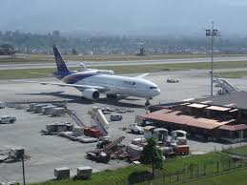
Transportation of this product to Nepal
No easy way
Easiest way be plane
http://www.leapp.aero/Case-Study/16/Asian-Development-Bank-/Civil-Aviation-Airport-Project-and-Airport-Master-Plan/
http://science.howstuffworks.com/transport/flight/modern/airplanes.htm
Notes:
There is no easy way to get this product for the manufacture to the Nepalese people. I believe that the easiest way would be to ship the product from the manufacture to the airport and then load it onto the plane. The plane would leave from the airport closest to the manufacture to the Nepal airport.

Slide 7
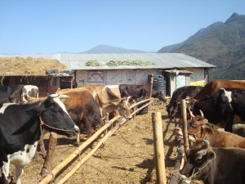
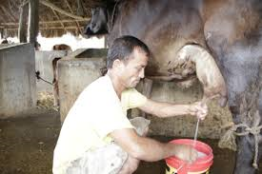
Benefits to Nepal
Safer milk to drink
Came be stored longer
Efficient way to pasteurize milk
Very energy efficient
Easy maintenance
http://pacnepal.org.np/volunteer-in-nepal/volunteer-in-cow-farm/
http://www.np.undp.org/content/nepal/en/home/ourwork/povertyreduction/successstories/dairy-farm-helps-hukum-live-like-a-master/
Notes:
There are lots of cows in Nepal but many farmers do not have an efficient way of pasteurizing the milk that they collect from them. Pasteurization is the most efficient way of decreasing the risks of pathogenic bacteria being in the milk and therefore increasing the safety of the milk being consumed by the people of Nepal. By export this milk pasteurization equipment the Nepalese farmers will be able to supply their families with safe milk to drink. Pasteurized milk came also be stored for longer periods of time therefore giving the farmers more of a chance to sell there milk at the markets. This product also is very energy efficient which means it does not require a ton of energy to run, this will decrease the running costs of the pasteurization equipment and also minimize the environmental impact. Also it is very user friendly when it comes to the maintenace and inspection of the pasteurizer.

Slide 8
Conclusion and Recommendations
Notes:
To conclude I believe that the Tetra Plex M Plate Heat Exchanger would be a good product for Canada to export Napel because it would benefit both countries. There are lots of positives with is product but with all positive there is always some negatives. One problem with this product for Nepal is that it is on the expensive side but more then one farmer could invest their money in this product. A problem with this product for Canada is that there is no guaranty that this product will sell well in Nepal and the company could end up loosing money.

Slide 9
Required Information
Shannon Crocker (scrocker@mail.uoguelph.ca
University of Guelph in partnership with IDRC, CIFSRF and DFAIT
Faculty Sponsor: Prof. Manish Raizada (raizada@uoguelph.ca)
Total presentation Time: (4min 21 sec)
“For further information: A detailed written evaluation of this export idea is posted on this website: http://agtradenepalcan.weebly.com/”

Slide 10
References
Canada Map. Map of Canada. [Website]. Retrieved from http://www.map-of-canada.org/
Embassy of Nepal. A Quick Look at Nepal. [Website]. Retrieved from http://www.nepembassy.org.uk/fact_file.php
LeJeune, J.T. Rajala-Schultz, P.J. (2009). Clinical Infectious Diseases. Unpasteurized Milk: A Continued Public Health Threat, 48 (1): 93-100). Retrieved from http://cid.oxfordjournals.org/content/48/1/93.short
Milk Facts. Heat Treatment and Pasteurization. [website]. Retrieved from http://www.milkfacts.info/Milk%20Processing/Heat%20Treatments%20and%20Pasteurization.htm
Tetra Pak Inc. Tetra Plex Plate Heating Exchangers. [company website]. Retrieved from http://edit.tetrapak.com/usprocessing/heat-exchangers/plate-heat-exchangers

