Slide 1
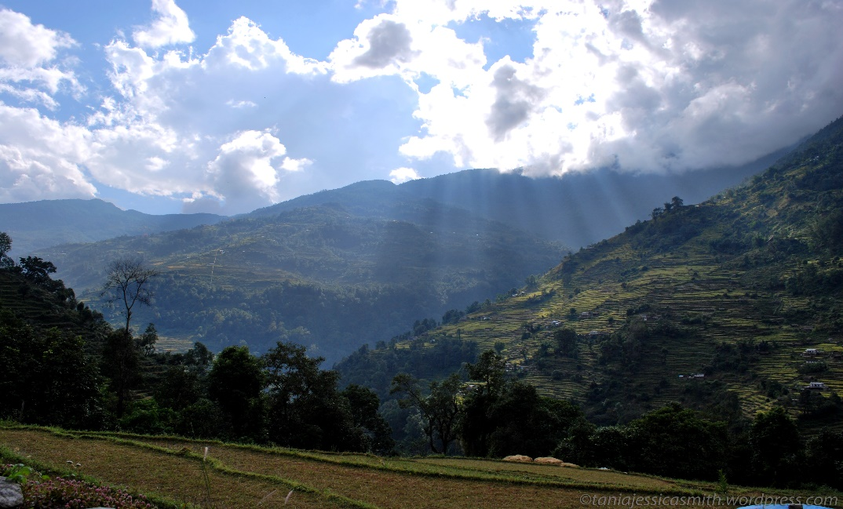
Promoting Canadian Agrifood Exports to Nepal
Taniajessicasmith.wordpress.com. Landscape, Poon Hill Trek, Nepal. [Photograph]. Retrieved from http://taniajessicasmith.wordpress.com/2012/06/12/landscape-poon-hill-trek-nepal/
With Biodegradable Polypropylene Mulch

Slide 2
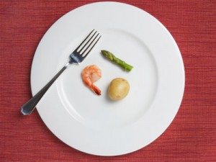
Introduction to Nepal
Food insecurity is high
41% consume less than the minimum calorie requirements
25.16% in poverty
JohnBarban.com. "LESS" doesn't mean "NOT ENOUGH“. [Photograph]. Retrieved from http://johnbarban.com/less-food-doesnt-mean-not-enough-food/

Slide 3
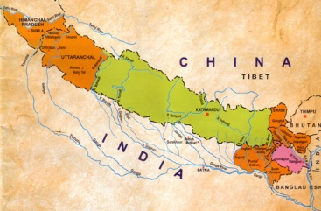
Introduction to Nepal
Landlocked country in South Asia
Borders with China and India
Has an area of 147 181 km²
IAS Our Dream. [Map of Nepal]. Retrieved from http://swapsushias.blogspot.ca/2014/01/why-should-chinese-presence-in-nepal.html#.VGTedE0tDLQ

Slide 4
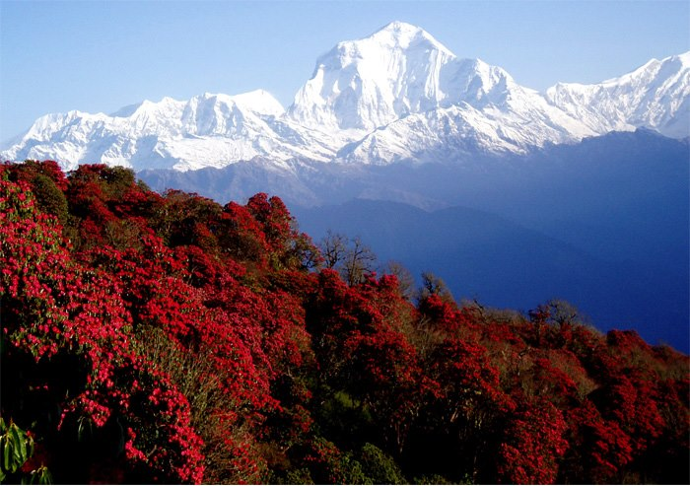
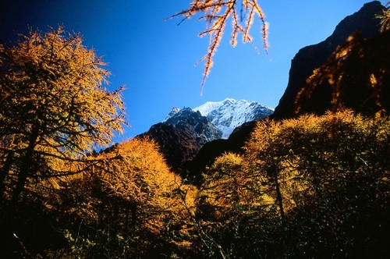
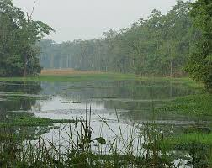
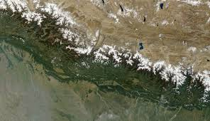
Seasons
Spring
Autumn
Yuuki Treks Pvt. Ltd. [The view of Mt. Dhaulagiri far behind, and forest covered by national Flower of Nepal, rhododendron]. Retrieved from http://yuukitreknepal.com/blog/2013/02/announcement-trekking-package-for-2013-spring-march-april-may/
SummitPost.org. Autumn in Nepal. [Photograph]. Retrieved from http://www.summitpost.org/autumn-in-nepal/541570
Summer: known as monsoon season
Winter
Wikipedia, the Free Encyclopedia. [Satellite image of Nepal]. Retrieved from http://en.wikipedia.org/wiki/Geography_of_Nepal
Annapurna Trekking. [Park region of Terai]. Retrieved from www.annapurna-trekking.com

Slide 5
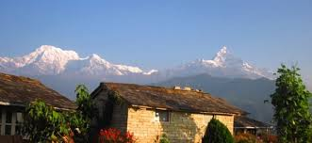
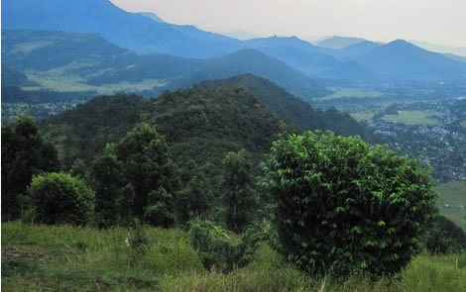
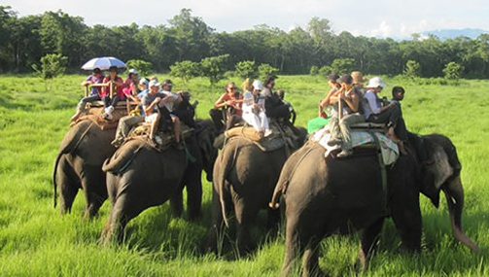
Agroecological Zones
There are three agroecological zones:
The Mountains
The Hills
The Terai
Volunteer Aid Nepal. Himalayan Region. [Photograph]. Retrieved from http://volunteeraidnepal.org/nepal/
Volunteer Aid Nepal. Hill Region. [Photograph]. Retrieved from http://volunteeraidnepal.org/nepal/
Volunteer Aid Nepal. Terai Region. [Photograph]. Retrieved from http://volunteeraidnepal.org/nepal/
The Terai is the most important for gricultural production

Slide 6
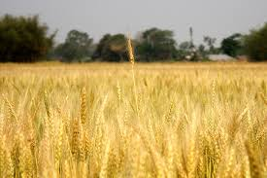
The Terai Eco-zone
Has an area of 34090 km²
Most rainfall occurs in monsoon season
47% of agricultural GDP comes from this region
Land is flat and fertile
Flickr. Golden Harvest. [Photograph]. Retrieved from https://www.flickr.com/photos/atultater/4483235551/
Average farm holding size is 1.26 ha

Slide 7
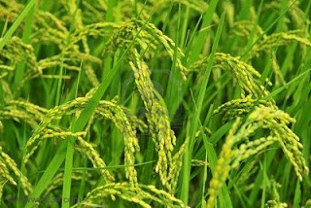
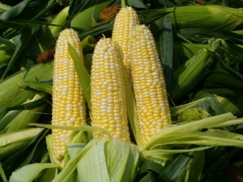
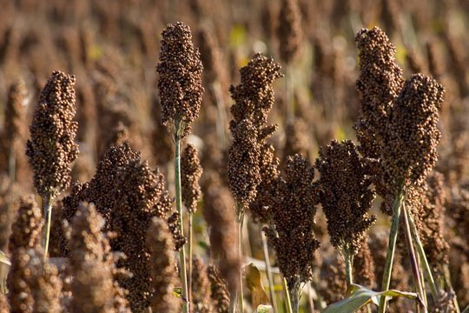
Food Production
Top food production of Terai region:
Paddy
Maize
Millet
Ashadi`s Blog.Paddy. [Photograph]. Retrieved from http://ashadi-hasan.blogspot.ca/
Agrodaily. [Maize]. Retrieved from http://agrodaily.com/2014/05/26/argentinas-2014-maize-production-estimated-above-average/
Apartment Therapy. [Millet]. Retrieved from http://www.thekitchn.com/good-grains-what-is-millet-67713

Slide 8
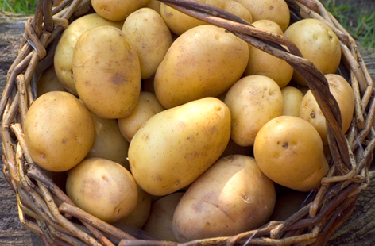
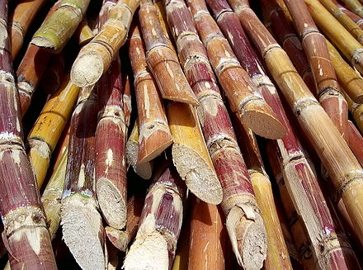
Food Production
Top food production of Nepal:
Oilseed
Potato
Tobacco
Tea
Sugarcane
Tesco. Potatoes. [Photograph]. Retrieved from http://realfood.tesco.com/glossary/potatoes.html
Wikipedia, the Free Encyclopedia. Sugarcane. [Photograph]. Retrieved from http://en.wikipedia.org/wiki/Sugarcane
Jute

Slide 9
Issues With Food Production
Rapid increase in population
78% of farming households own their own land
Most farms are less than 1 ha

Slide 10
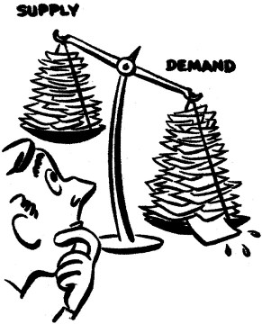
Issues With Food Production
Supply is not meeting demand
Page Lines. [Cartoon of supply vs. demand]. Retrieved from http://leadenergy.org/2010/09/supply-demand-energy-innovation/

Slide 11
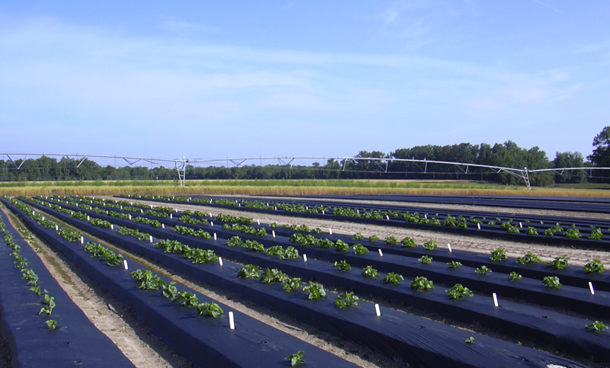
Solution
A solution is to introduce biodegradable polypropylene mulch
Can increase yield by 2-3 times
Constantine Alexander’s Blog. [Plastic Mulch]. Retrieved from http://www.constantinealexander.net/2013/10/plastic-mulching-reduces-farmland-bird-numbers-and-diversity.html

Slide 12
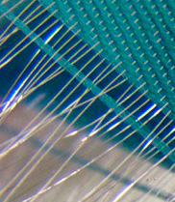
Biodegradable Polypropylene Mulch
Made of starch from plants as well as other polymers and plasticizers
Produced by weaving and/or attaching fibers together
Indaco Manufacturing Ltd’s biodegradable mulch made of biodegradable ingredients
CSIRO. Metallic threads woven on the CCI Sample Weaving Machine. [Photograph]. Retrieved from http://www.csiro.au/Organisation-Structure/Divisions/CMSE/Fibre-Science/Fibre-processing-creates-new-fibrous-structures-and-solutions.aspx

Slide 13
Biodegradable Polypropylene Mulch
Purpose:
Raises soil temperature
Reduces fertilizer leaching
Reduces amount of weeds
Decreases amount of drowning crops

Slide 14
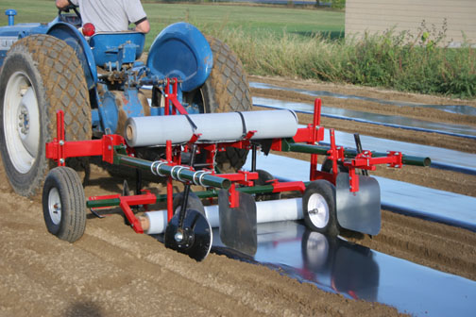
Prices
Cheapest from Indaco Manufacturing Ltd is $266.52 for 5000' x 36“ of .8mil.
Price can range from $350 to $700 USD per acre including installation and removal costs
Mechanical Transplanter. Model 90 Mulch Layer. [Photograph]. Retrieved from http://www.mechanicaltransplanter.com/layer.html

Slide 15
Benefits
Benefits to Nepal:
Benefits to Canada:
Promotes more rapid growth and earlier crop yields
Create more business ties with Nepal
Bring in more revenue
Reduces weed growth
Reduces leaching
Allows farmer to earn more money

Slide 16
More Information
By Leenoy Finer
University of Guelph in partnership with the IDRC CIFSRF and DFAIT
Video length: 4 minutes 52 seconds
Faculty Sponsor: Prof. Manish Raizada (raizada@uoguelph.ca)
AgTrade Nepal Canada website: http://agtradenepalcan.weebly.com/
For further information on Indaco Manufacturing Ltd’s biodegradable mulch, visit their website: http://indaco.ca/agricultural-mulch-film.html

Slide 17
/
References
http://www.nationsonline.org/oneworld/map/nepal-administrative-map.htm
http://web.gps.caltech.edu/~avouac/nepal_trip/geography.htm
http://web.gps.caltech.edu/~avouac/nepal_trip/geography.htm
http://www.ifpri.org/sites/default/files/publications/Agriculture_seed_and_innovation_in_Nepal.pdf
http://documents.wfp.org/stellent/groups/public/documents/ena/wfp219805.pdf
http://www.hki.org/working-worldwide/asia-pacific/nepal/
http://www.fao.org/ag/AGP/AGPC/doc/counprof/Nepal/nepal.htm
http://pods.dasnr.okstate.edu/docushare/dsweb/Get/Document-1099/F-6034%20web.pdf
http://unapcaem.org/activities%20files/a07/country%20paper-nepal%202(hanoi%2004).pdf
http://unapcaem.org/activities%20files/a07/country%20paper-nepal%202(hanoi%2004).pdf

