Slide 1
Promoting Global Horticultural Inc. Cut Flower Sleeves in Nepal
Evan Klein
University of Guelph

Slide 2
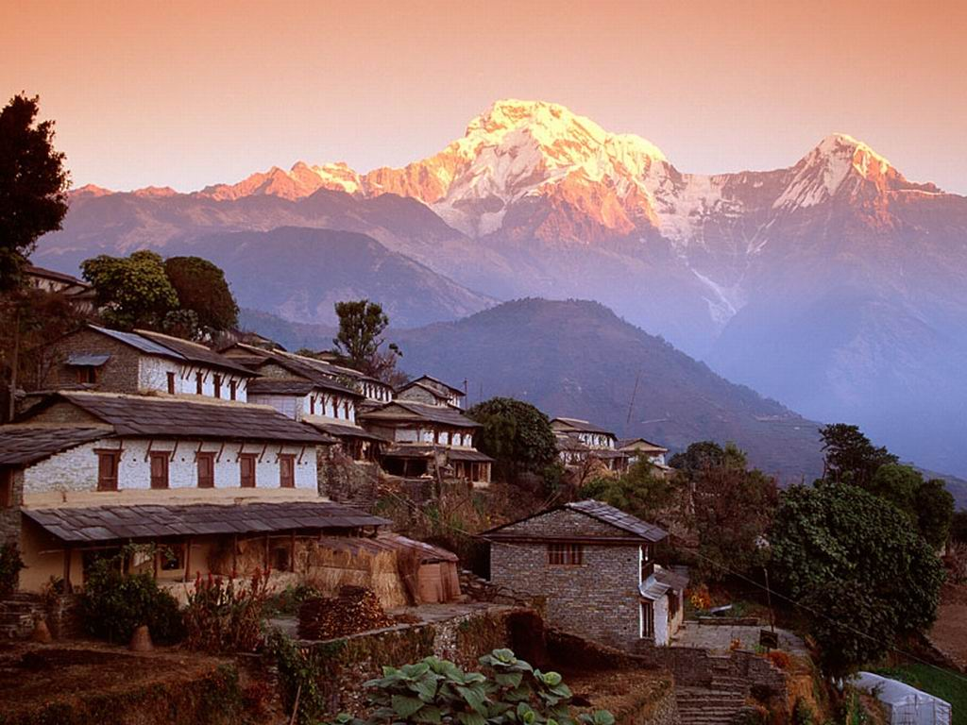
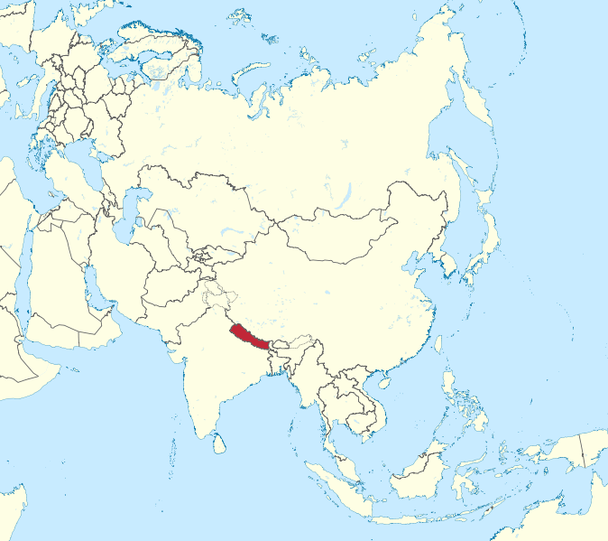

Slide 3
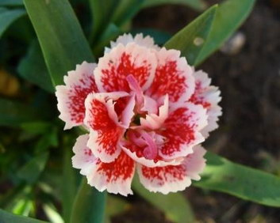
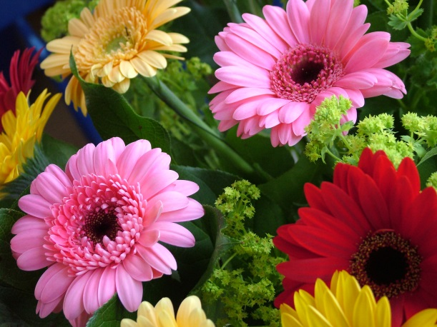
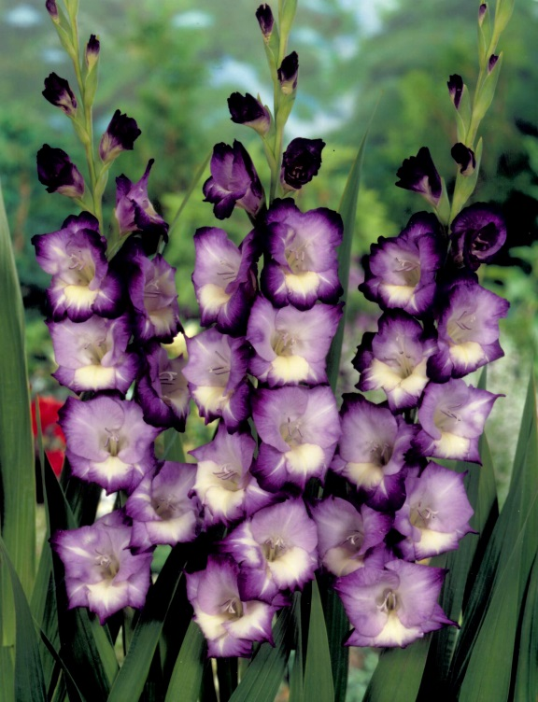
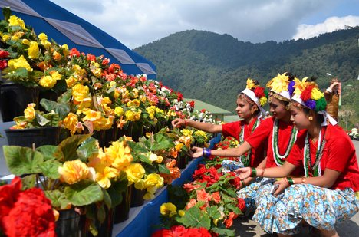
Carnation
Gerbera
Dutch and Local Roses
Gladiolus

Slide 4
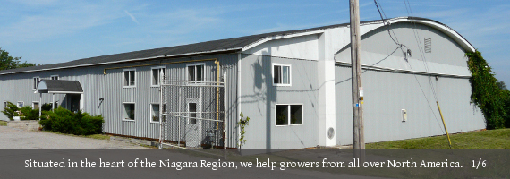
Beamsville, Ontario
Biologicals, Plant tags, Growing Mediums, Fertilisers,
Crop Management, Horticultural Systems, Greenhouse Supplies

Slide 5
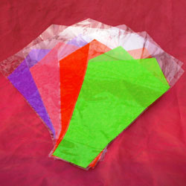
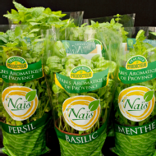
Cast Polypropylene (CPP)
Bio-oriented Polypropylene (BOPP)
Bio-based Packaging
>100% biodegradable

Slide 7
Evan Klein eklein02@uoguelph.ca
University of Guelph in partnership with IDRC CIFSRF and DFAIT
Faculty Sponsor: Prof. Manish Raizada (raizada@uoguelph.ca)
Presentation time 4:50
Gauchan, D. P., et al. "Current Status of Cut Flower Business in Nepal." Kathmandu University Journal of Science, Engineering and Technology 5.1 (2009): 87-98. Print.
Shrestha, A., Shrestha, D., and Joshi, S. D. 1999. Cut Flower Business in
NepalPerformance and Prospects. Master thesis, Kathmandu University School of Management.
Mountains :http://www.himalayantrekking.com/Nepal/images/5.jpeg
Map: http://upload.wikimedia.org/wikipedia/commons/thumb/9/91/Nepal_in_Asia_(-mini_map_-rivers).svg/674px-Nepal_in_Asia_(-mini_map_-rivers).svg.png
Carnation: http://www.flowers-cs.com/Pictures/CARNATION.jpg
Gladiolus: http://www.whatabloom.com/blog/wp-content/uploads/2012/08/gladiolus-3.jpg
Gerbera: http://upload.wikimedia.org/wikipedia/commons/5/5f/Gerbera_farben.JPG
Kids and Flowers: http://cdn5.wn.com/pd/28/30/9f7163fc0277f7357a79b16ccf0a_grande.jpg
Bouquet: http://trendseve.com/wp-content/uploads/2013/11/indian-bridal-white-bouquet.jpg
Remaining images are from Global Horticultural inc. webpage

